Slide 1
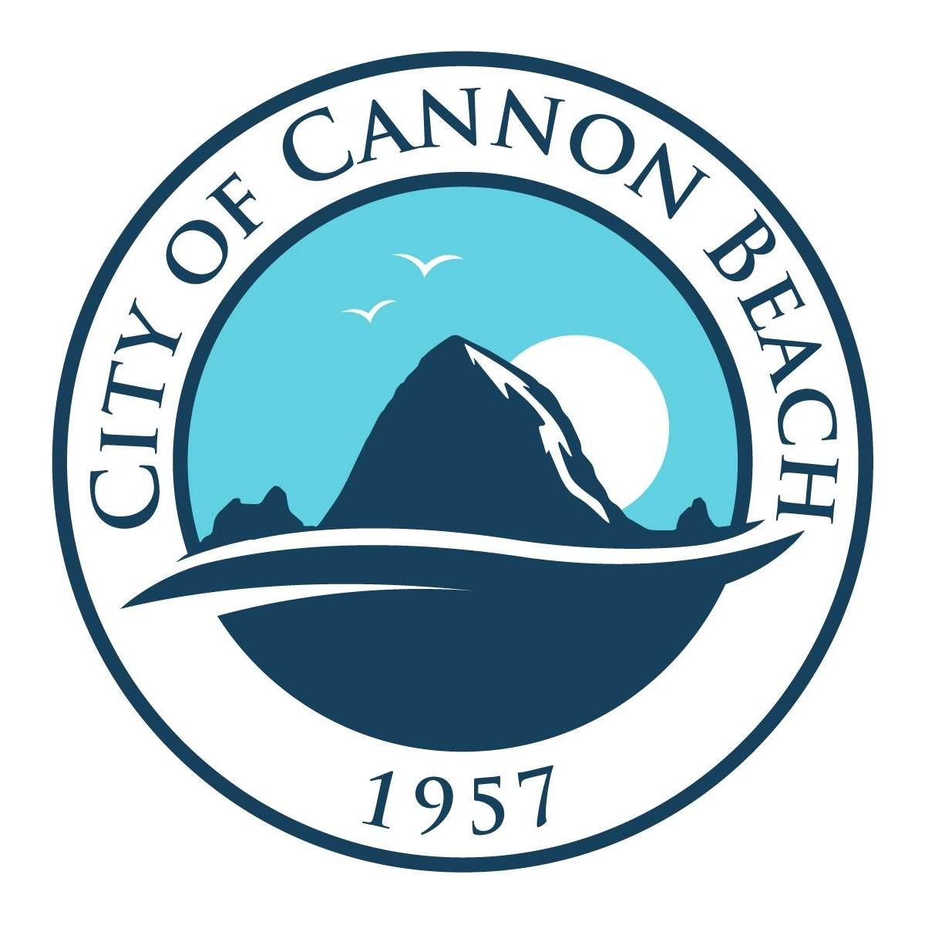

Slide 2
WHO IS ZCS: ZCS provides engineering and architectural services for our clients throughout the Pacific Northwest. The firm has been the engineer and architect of record for the design of many commercial buildings and general planning projects involving government agencies, municipalities, businesses, and private individuals.
O’Brien
WHY ZCS: ZCS was introduced to the City of Cannon Beach through a mutual associate, O’Brien Construction.
O’Brien and ZCS have an extensive relationship dated back to 2012. Throughout this time we have completed several successful projects along the north coast.

Slide 3
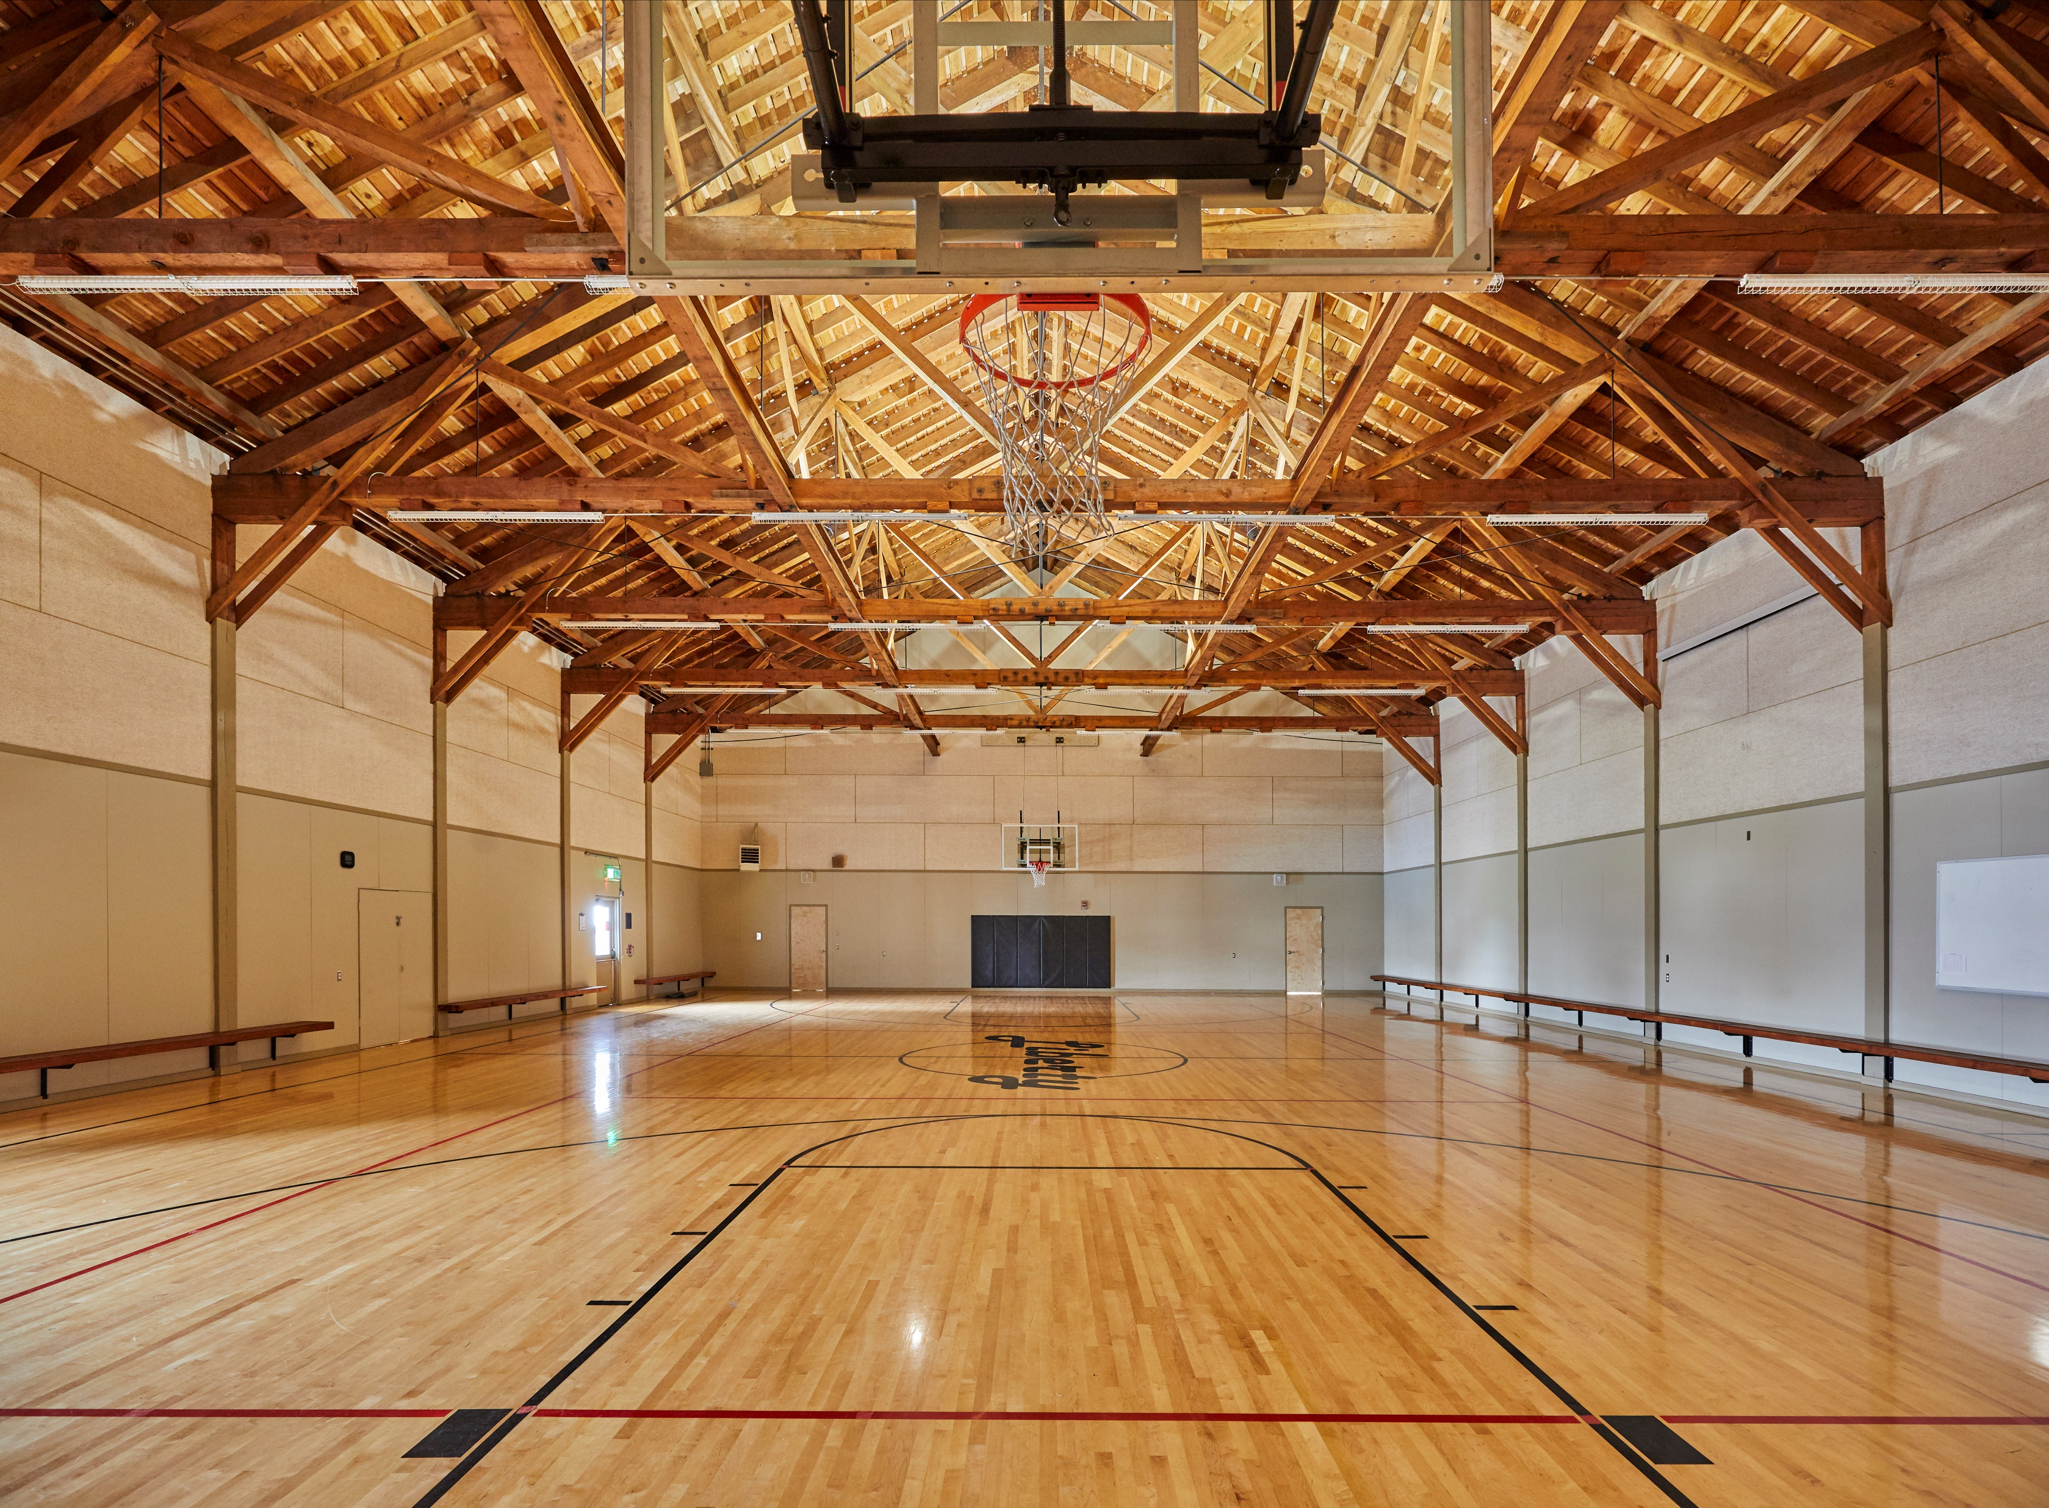
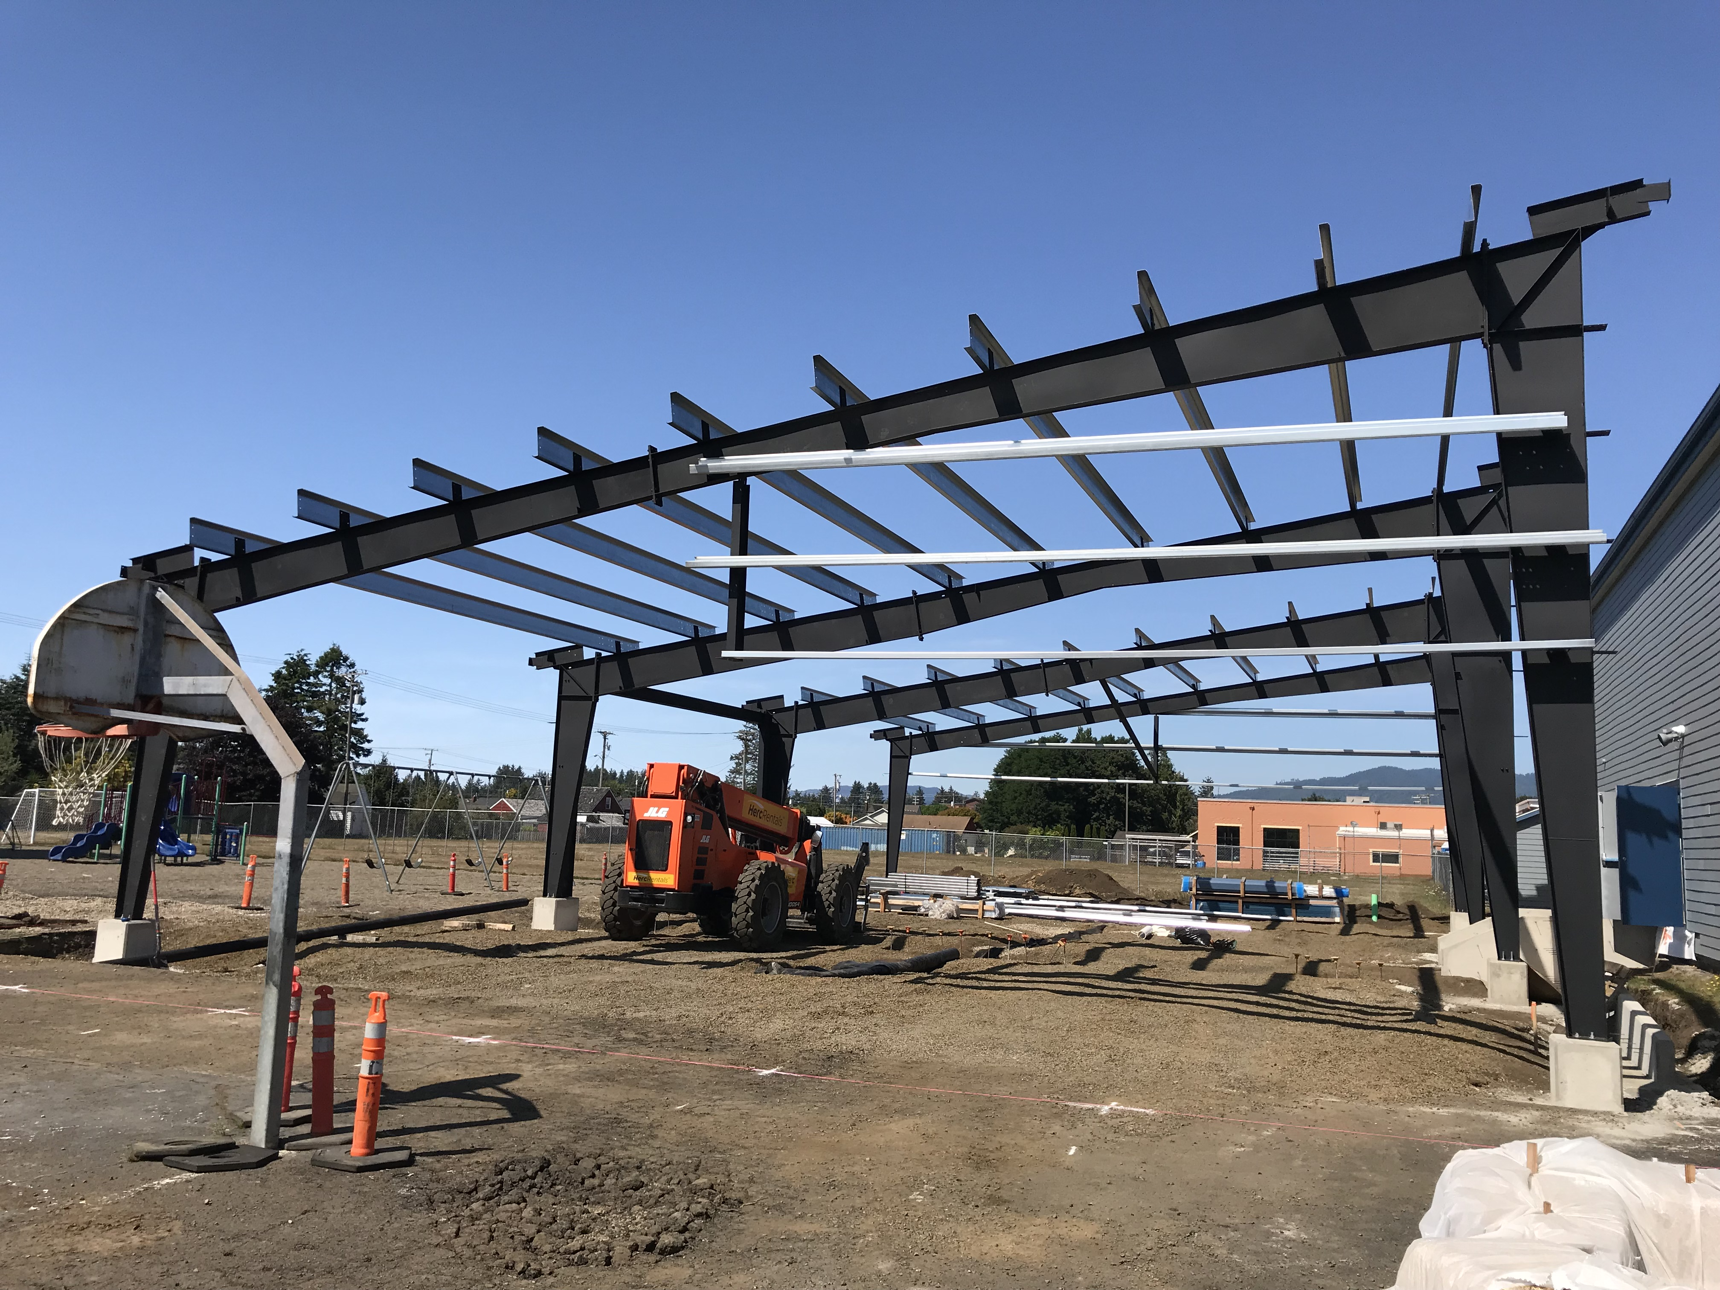
O’Brien
ZCS & O’BRIEN PROJECTS:
Nehalem Elementary
Liberty Elementary
East Elementary
Garibaldi Grade School
Nestucca Elementary
Nestucca High School

Slide 4
CANNON BEACH ELEMENTARY
BUILDING EVALUATION REPORT
REPORT OUTLINE:
Building Background
Visual Inspection
Seismic Deficiencies
Main Building
Gymnasium
Structural Rehabilitation Recommendations
Architectural Code Summary
Changing Occupancies
Obtaining a COA
Architectural Deficiencies
ADA
Weather damage
Cost Estimate

Slide 5
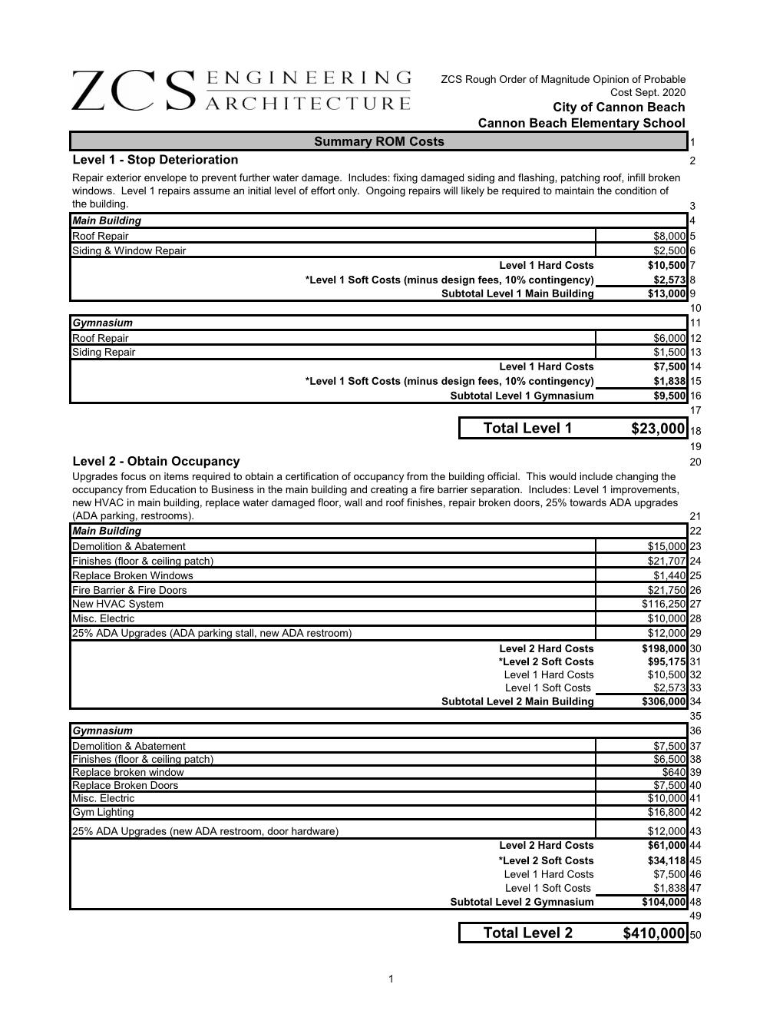
CANNON BEACH ELEMENTARY
BUILDING EVALUATION REPORT
Cost Estimate
Level 1 – Stop Deterioration
Level 2 – Obtain Occupancy
Level 3 – Tenant Improvement Project
Level 4 – Model Community Center

Slide 6
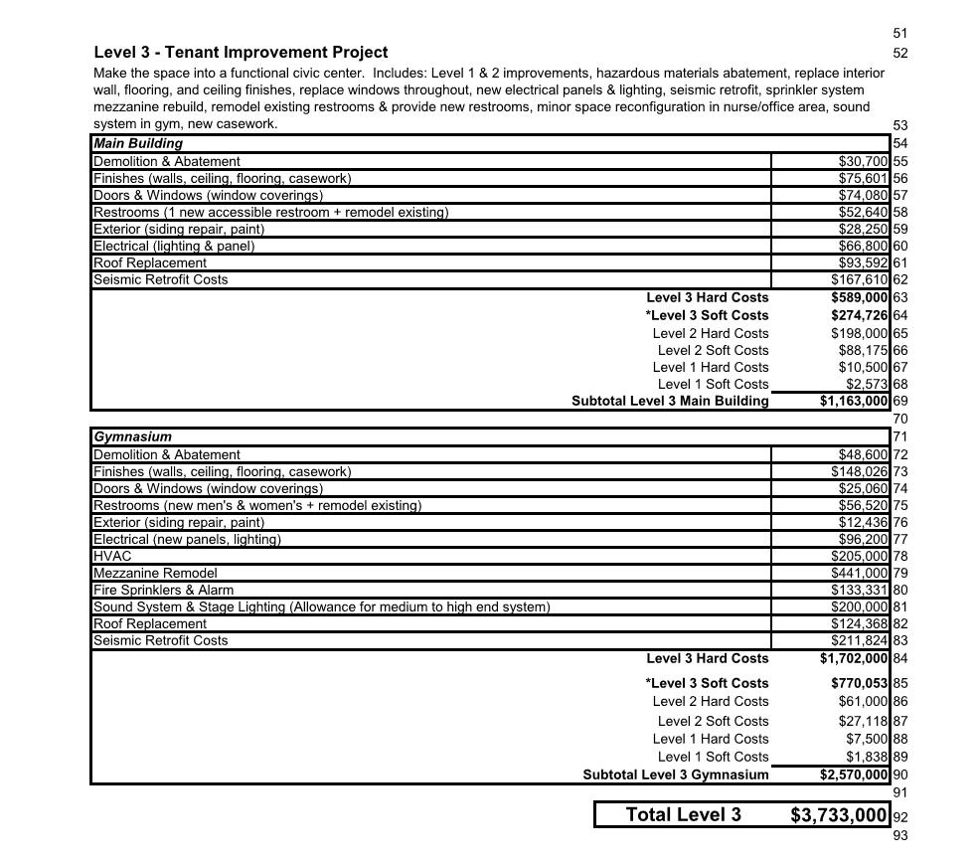
CANNON BEACH ELEMENTARY
BUILDING EVALUATION REPORT
Cost Estimate
Level 1 – Stop Deterioration
Level 2 – Obtain Occupancy
Level 3 – Tenant Improvement Project
Level 4 – Model Community Center

Slide 7
THANK YOU
QUESTIONS?

